Slide 1
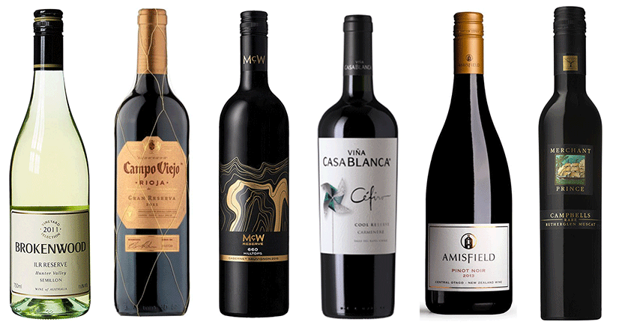
Wine Review Analysis
Wes Stanis

Slide 2
Objectives
Which country produces the best wine?
Predict which country produced a wine
Predict what attributes will create an above average wine

Slide 3
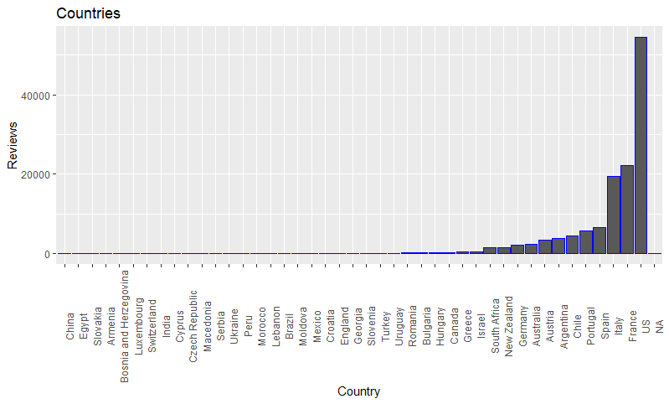
Countries vs Reviews

Slide 4
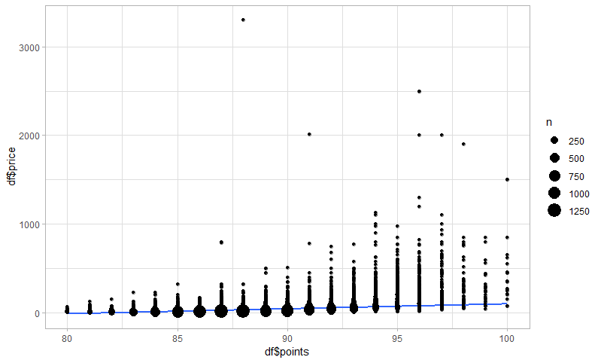
Points vs Price
Château les Ormes Sorbet 2013 Médoc
PRICE $3300,
VARIETY Bordeaux-style Red Blend
APPELLATION Médoc, Bordeaux, France
WINERY Château les Ormes Sorbet
Points Summary
Min. 1st Q. Median Mean 3rd Q. Max.
80.00 86.00 88.00 88.45 91.00 100.00

Slide 5
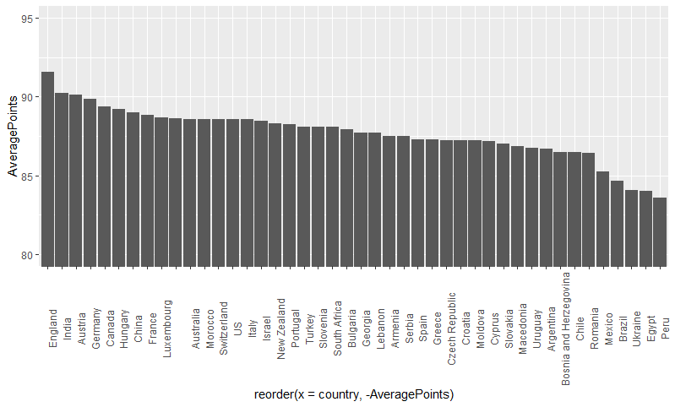
Top Countries
Country Average Points
1 England 91.6
2 India 90.2
3 Austria 90.1
4 Germany 89.9
5 Canada 89.4
6 Hungary 89.2
7 China 89
8 France 88.8
9 Luxembourg 88.7

Slide 6
Rules Mining
lhs rhs support confidence
1 {points=(96,100]} => {price=very expensive} 0.0022928192 0.8324022
2 {points=(92,96],variety=Tinto Fino} => {price=very expensive} 0.0001384924 0.8181818
3 {points=(96,100],variety=Nebbiolo} => {price=very expensive} 0.0001769626 0.8846154
4 {points=(96,100],province=Piedmont} => {price=very expensive} 0.0001769626 0.8846154
5 {points=(96,100],province=Burgundy} => {price=very expensive} 0.0001692685 0.9565217
lift count
[1] 8.172545 298
[2] 8.032929 18
[3] 8.685175 23
[4] 8.685175 23
[5] 9.391153 22

Slide 7
t-Test
Comparing point averages from the US and England
t = -14.055, df = 73.567, p-value < 2.2e-16

Slide 8
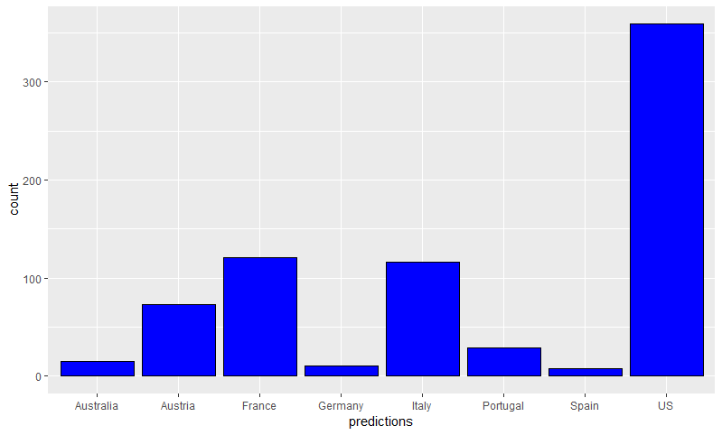
SVM:Countries 81% Accurate (wines above 94)
3-fold cross-validation on training data:
Total Accuracy: 81.06829
Single Accuracies:
81.94726 82.1501 79.10751

Slide 9
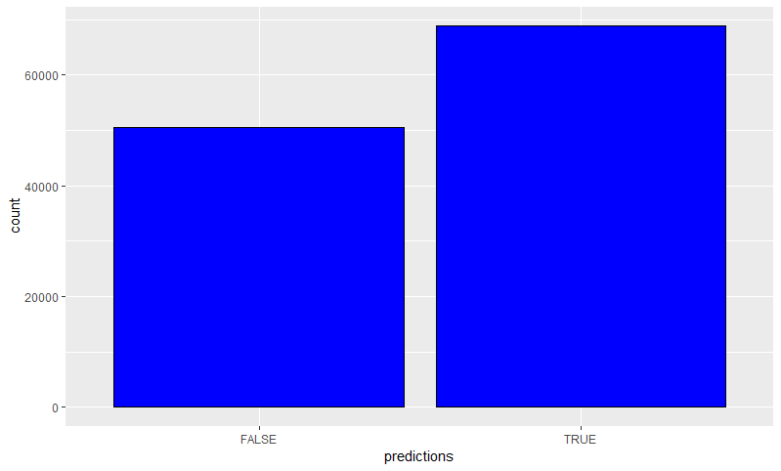
SVM: Wines over 87
3-fold cross-validation on training data:
Total Accuracy: 70.18634
Single Accuracies:
69.58955 70.7635 70.20484
predictions
FALSE:50517
TRUE :68848

Slide 10
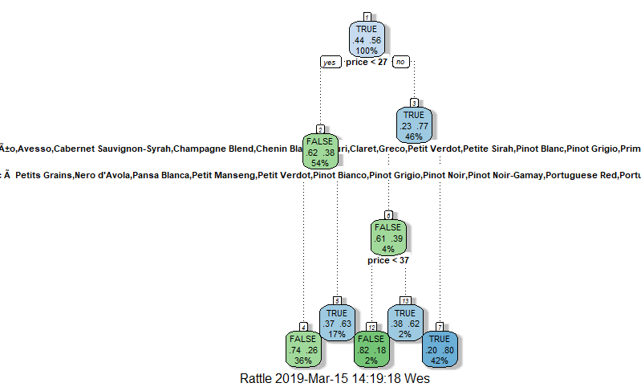
Decision Tree: Wines over 87
Variable importance
price variety country
46 44 10

Slide 11
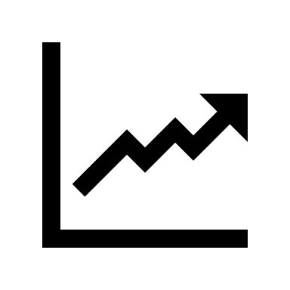
Linear Model
Multiple R-squared: 0.2092, Adjusted R-squared: 0.2089
F-statistic: 744 on 43 and 120931 DF, p-value: < 2.2e-16
Points by the price and country

Slide 12
Naïve Bayes: Wines over 87
-Confusion Matrix:
Reference
Prediction FALSE TRUE
FALSE 674 116
TRUE 37 783
-Accuracy : 0.905
95% CI : (0.8896, 0.9189)
No Information Rate : 0.5584
P-Value [Acc > NIR] : < 2.2e-16

Slide 13
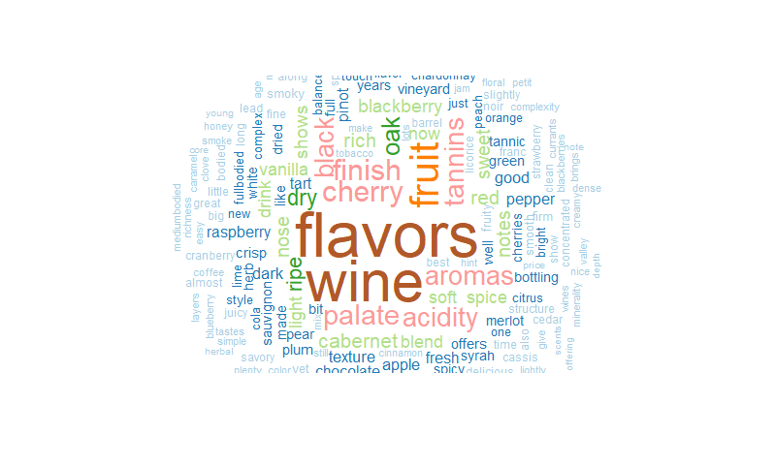
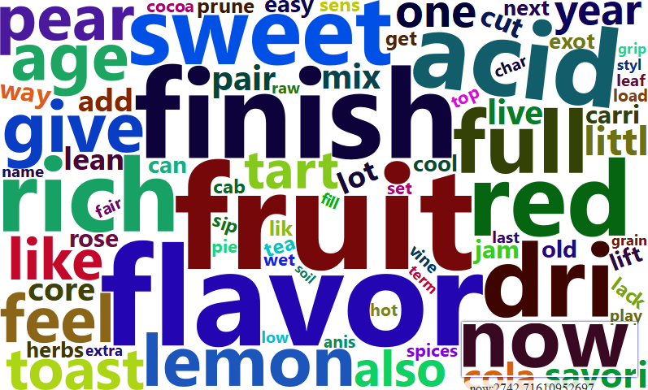
Descriptions WordClouds
Word Frequency fruit 4695.952 flavor 4486.078 finish 4019.659 aroma 3866.869 drink 3835.898 ripe 3736.519

Slide 14
Conclusion
England makes the best rated wines
Europe in general makes the best wines
Price will impact whether the wine is above average
Country does not have much value in predicting wines rating above average
Possibly another analysis can be done discretizing by continent

